Slide 1



Welcome Everyone! 👋
👨‍ 💻
Team Members:
Promod Chandra Das (ID: 231002005)
Chinmoy Debnath (ID: 231902029)
🎓 Submitted to: Prof. Dr. Md. Ahsan Habib (Tareq)

Slide 2

HTTP/2
01
02
03
Improvements
Introduction
Limitations
04
05
06
Interleaving Frames
Prioritizing Frames
Summary

Slide 3

01
Introduction
Why speeding up delivery matters, and how protocols evolved to solve that.

Slide 4
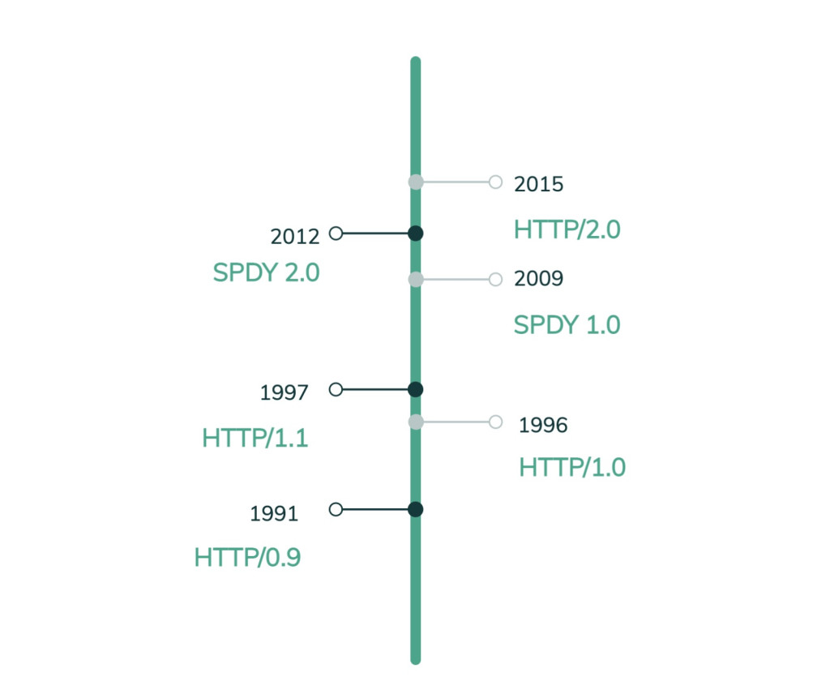
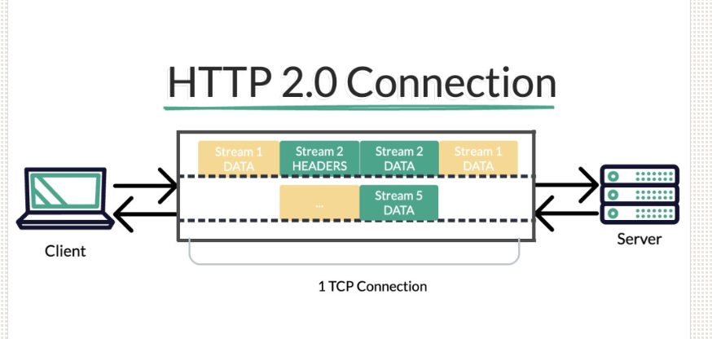
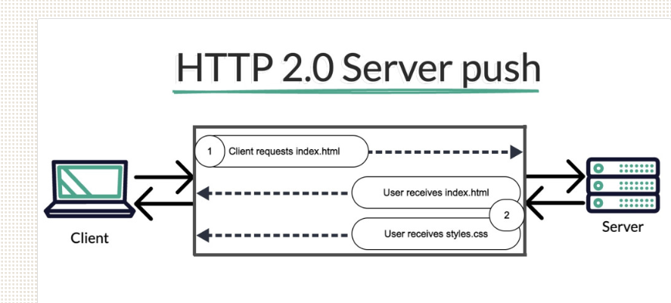
Why is HTTP/2 important?
Topic
The Evolution of HTTP
The Need for HTTP/2
Server Push

Slide 5

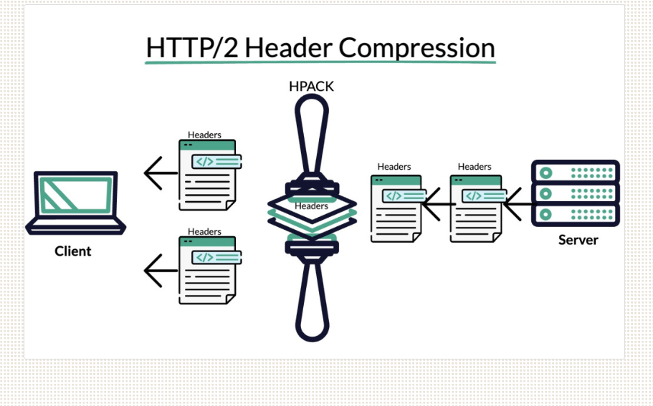



Header Compression
This compression technique reduces the size of the headers.
reduce the overhead associated with HTTP headers..
resulting in lower bandwidth consumption and faster communication between the client and server.
The mechanism uses the HPACK (HTTP/2 Static Table and Huffman Encoding) algorithm to compress headers.
HPACK utilizes techniques such as Huffman encoding, indexing, and dynamic table management to minimize the size of headers without losing any critical information..

Slide 6
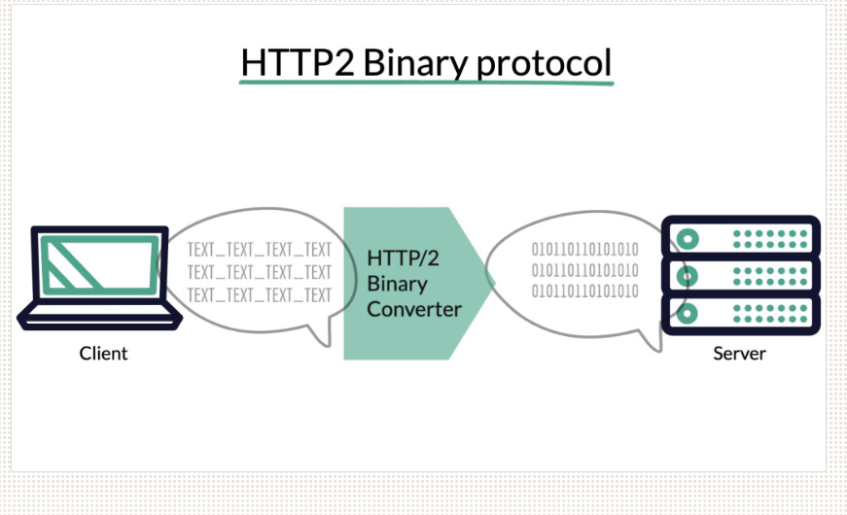
HTTP2 Binary protocol

Slide 7
02
HTTP/2
Limitations

Slide 8





HTTP/2 -Limitations
HTTP/2 Limitations
While HTTP/2 offers numerous advantages, it is essential to be aware of its limitations.
Topic
Topic
Limited browser support.
Upgrade Complexity and Higher Server Resource Utilization
Topic
Topic
Latency and Slow Start
Head-of-Line Blocking.

Slide 9
03
HTTP/2
Improvements

Slide 10
HTTPImprovements
Header Compression (HPACK)
Multiplexing
Multiple requests and responses can be sent simultaneously over a single TCP connection..
HTTP/2 compresses headers using HPACK, reducing overhead and speeding up data transmission
TOPIC
Stream Prioritization
Reduced Latency
Allows the client to assign priority to different streams, improving resource loading efficiency.
page load times are significantly improved.

Slide 11
04
http/2
Interleaving Frames

Slide 12



Interleaving Frames
Reduced Head-of-Line Blocking
Frame Interleaving
prevent delays
interleaved
Multiple Streams Over One Connection
Improved Speed and Efficiency
multiple streams to send frames over a single TCP connection.
faster page loading

Slide 13
05
http/2
Prioritizing Frames

Slide 14




Prioritizing Frames
Streams Have Priorities
Better Resource Management
Each stream can be assigned a weight (1–256) to indicate its importance.
Helps deliver critical resources first (like HTML/CSS)
TOPIC
Dynamic Re-Prioritization
Dependency-Based Prioritization
Streams can depend on other streams, forming a tree structure to manage complex priorities.
Priorities can be adjusted anytime based on changing needs during page load.

Slide 15
06
Http/2
Summary

Slide 16




Summary
Learned: Multiplexing & Binary Framing
Future Development: Server Push & Security
Remove: Multiple TCP Connections
Improve: Header Compression and Prioritization

Slide 17

THANK YOU

